Slide 1


Slide 2

Pubconf is sponsored by

Slide 3
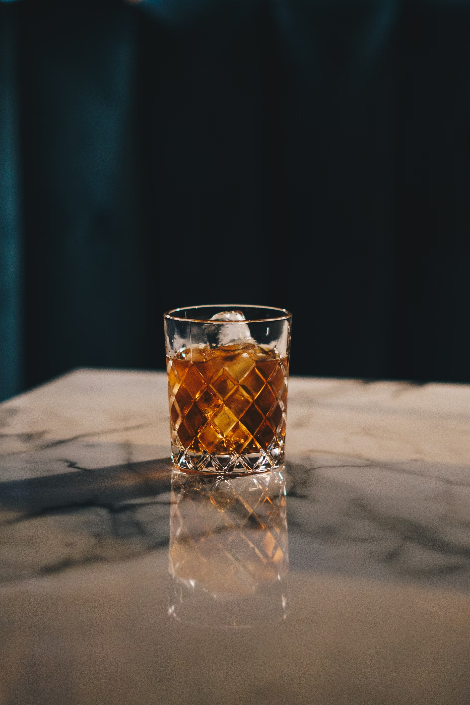

We sponsored this
And we sponsored this

Slide 4

KCDC is cool

Slide 5
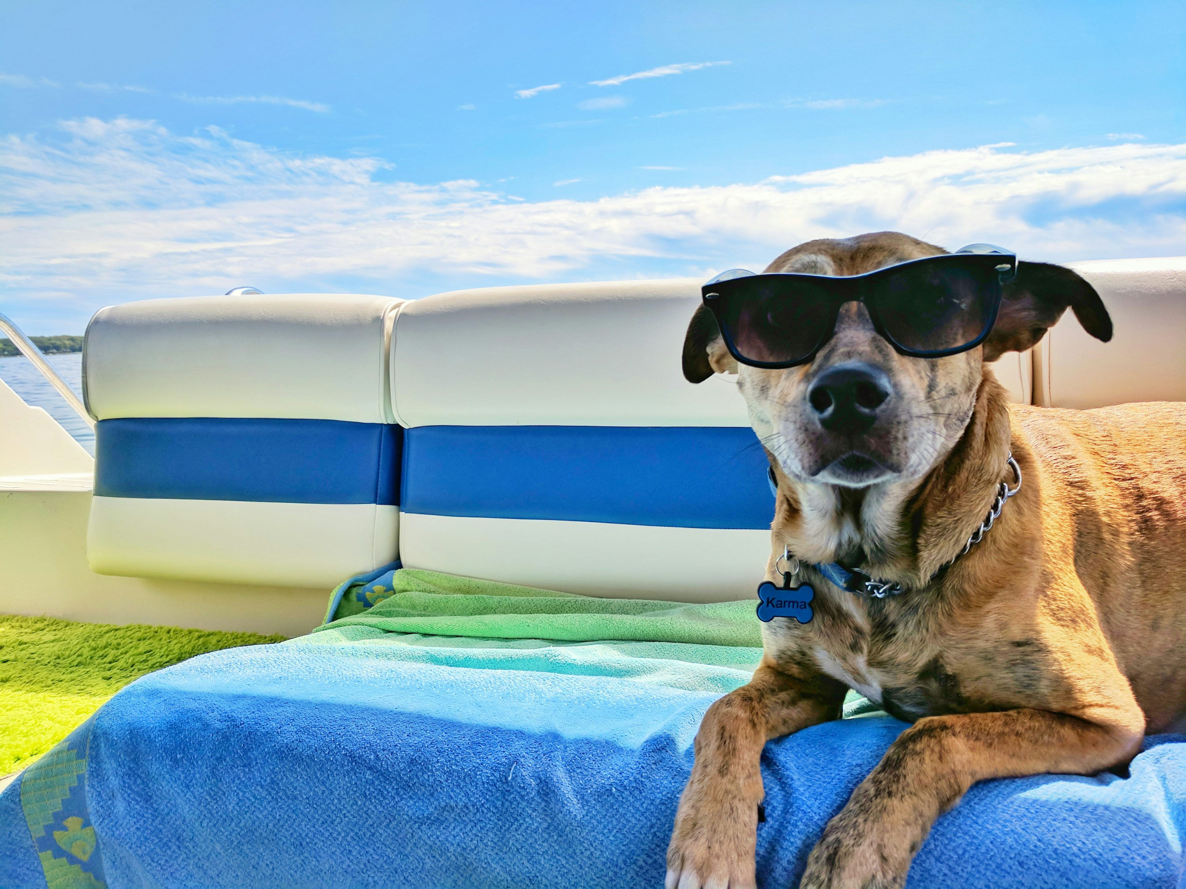
And we also sponsored this
We ain’t cheugy

Slide 6
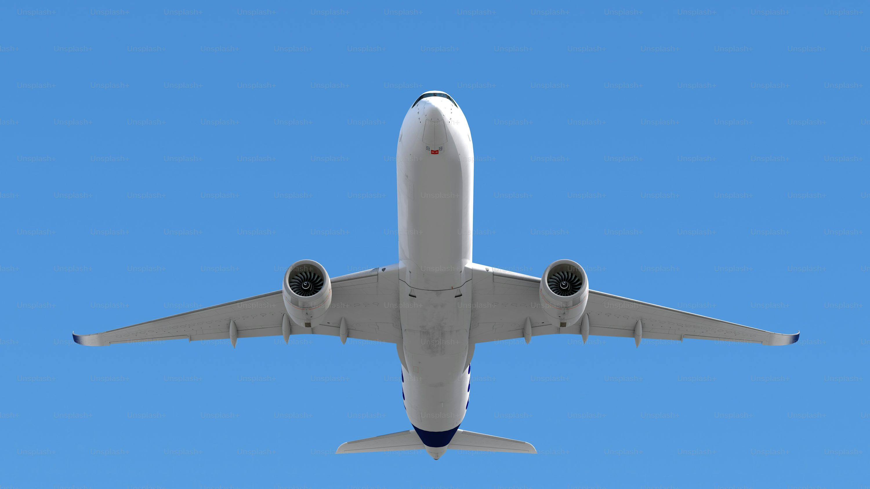
We sponsored speaker travel!

Slide 7
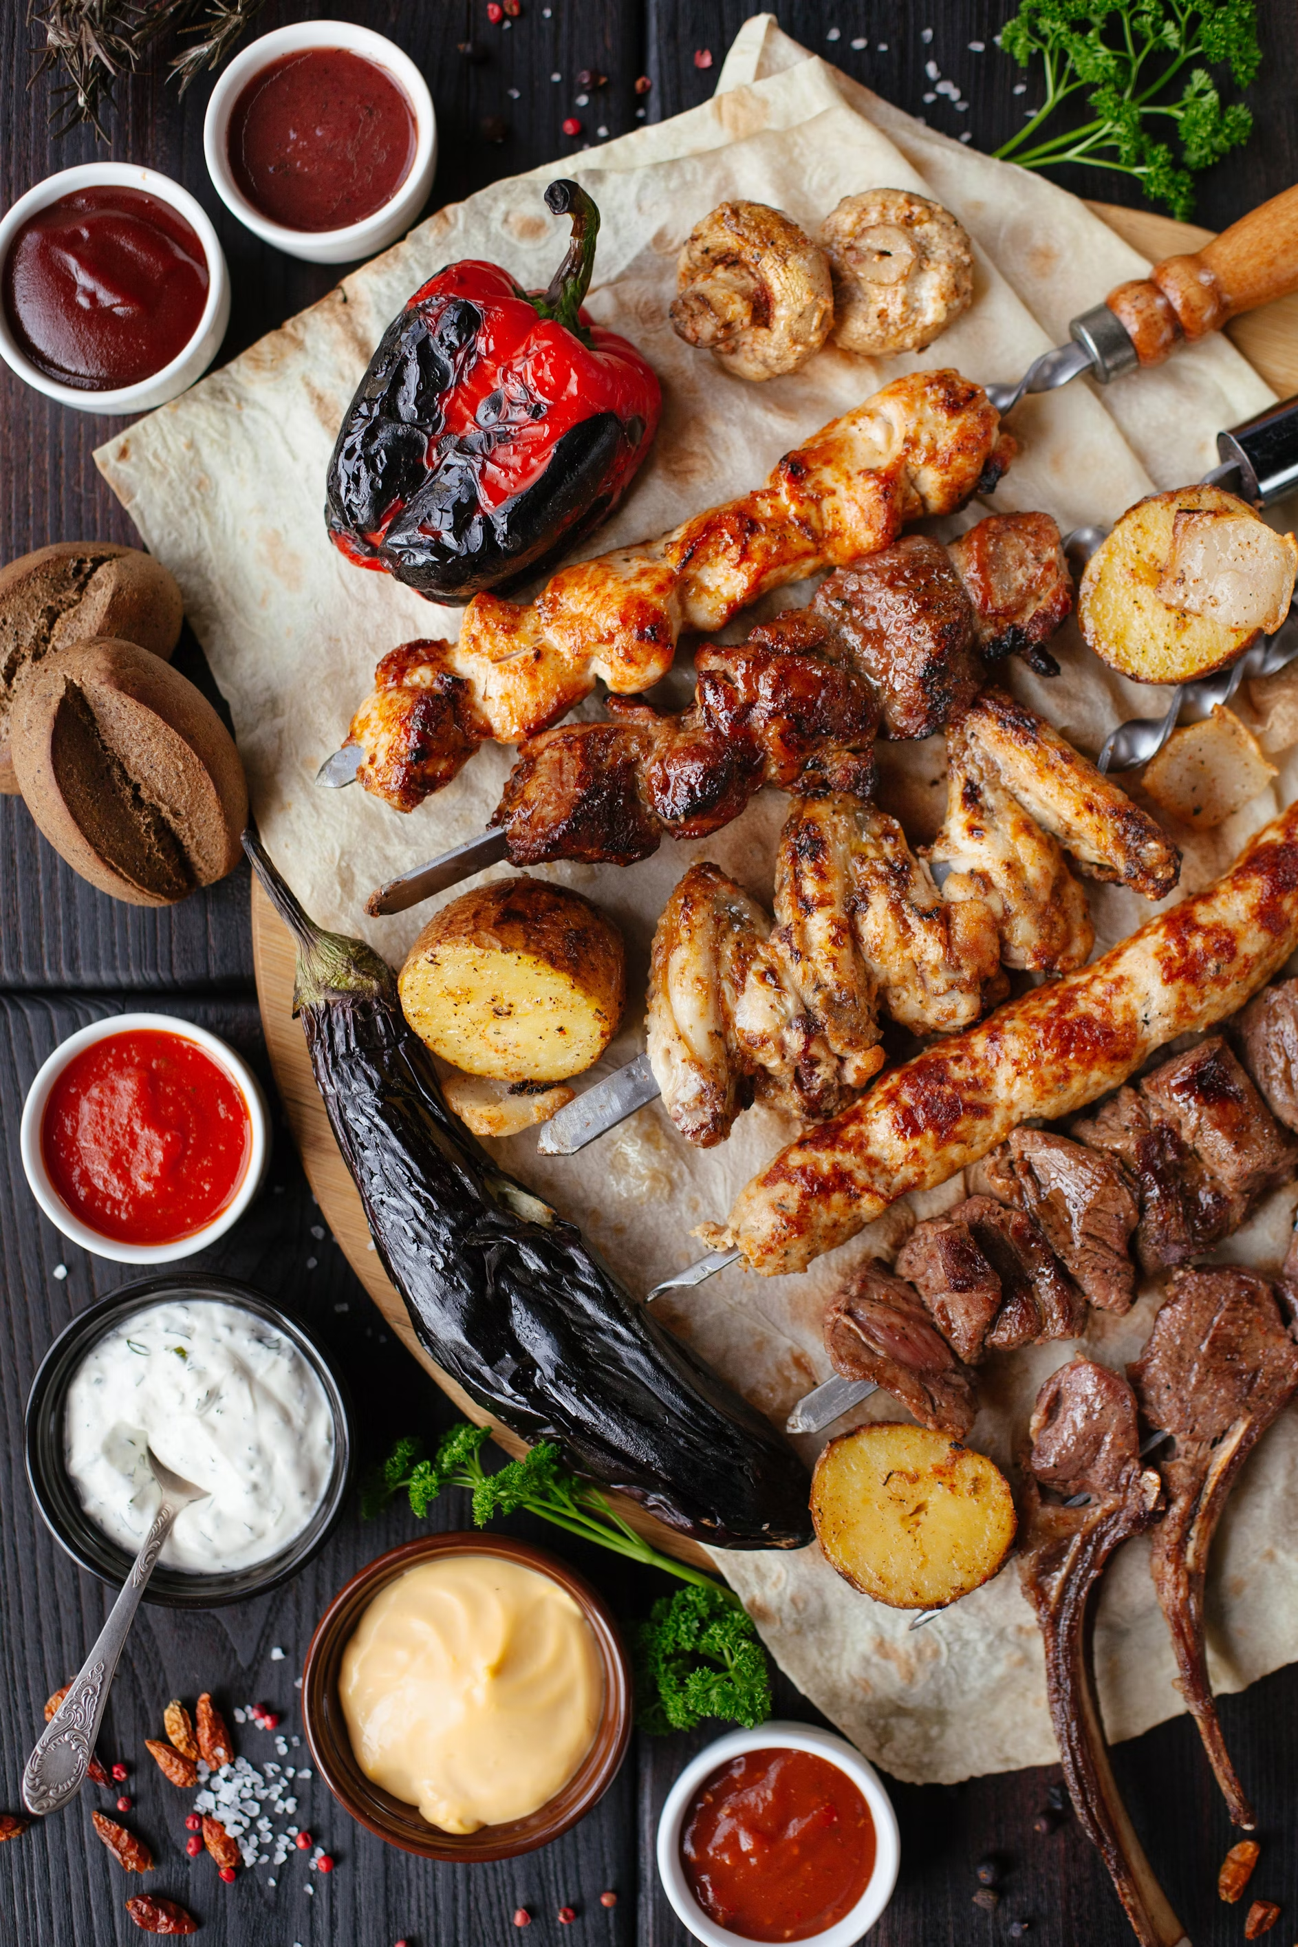

And we sponsored this

Slide 8
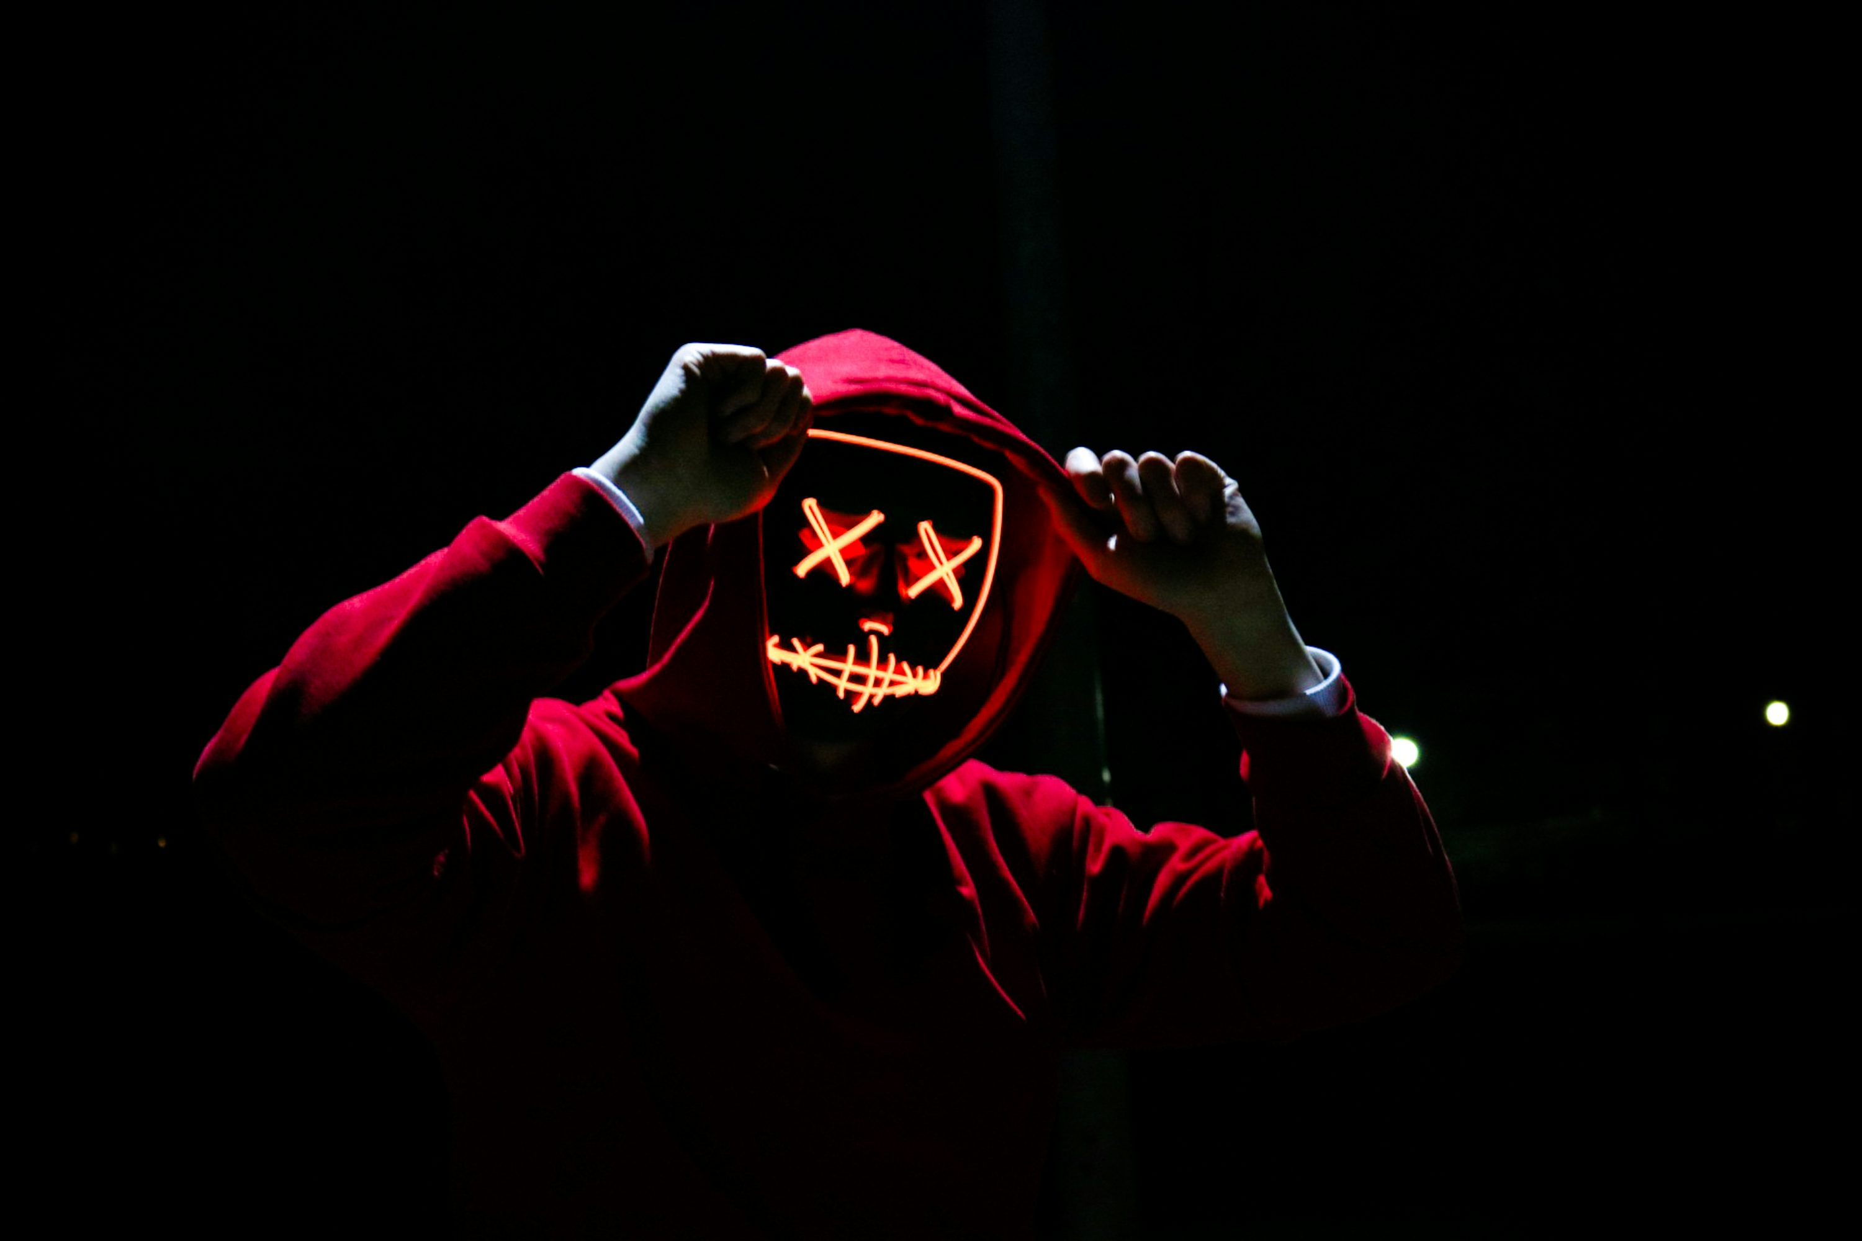
KCDC == COOL

Slide 9
2034
Sponsored by

Slide 10
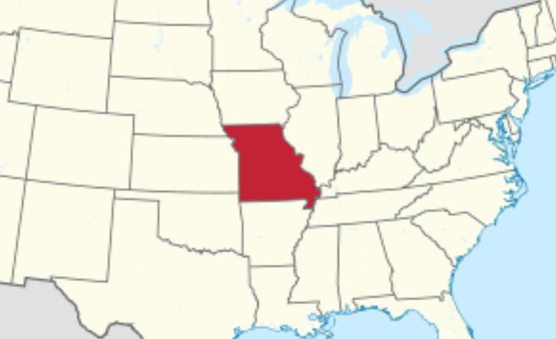
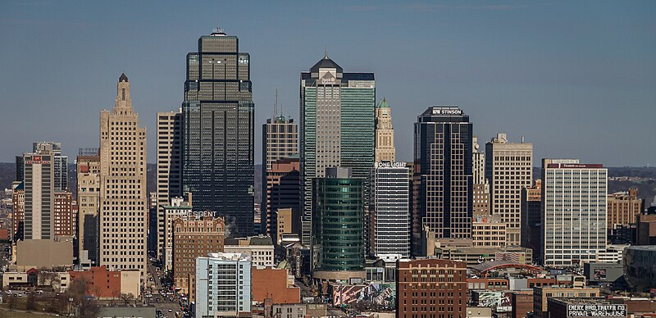

Slide 11
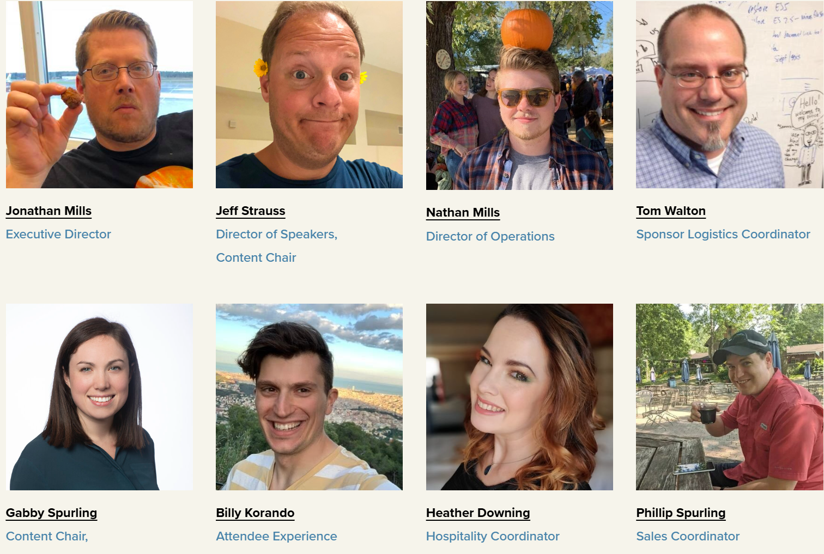

Slide 12
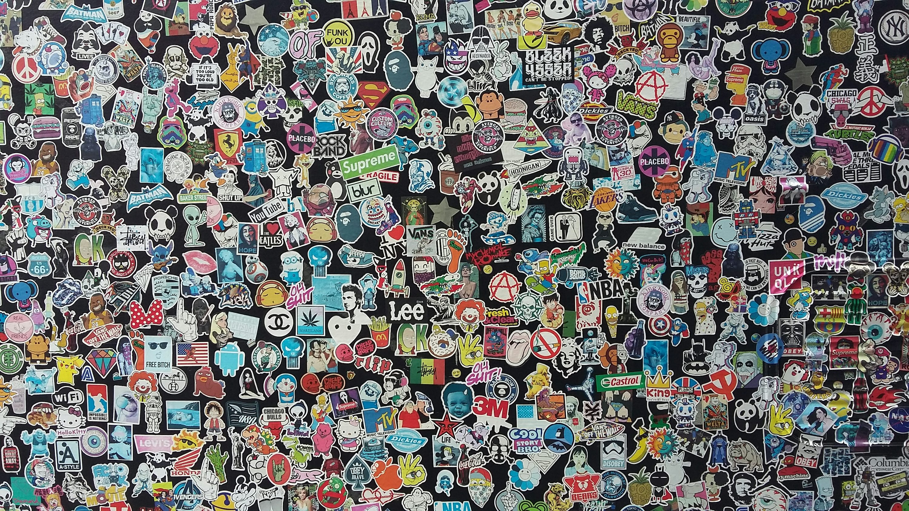


Slide 13
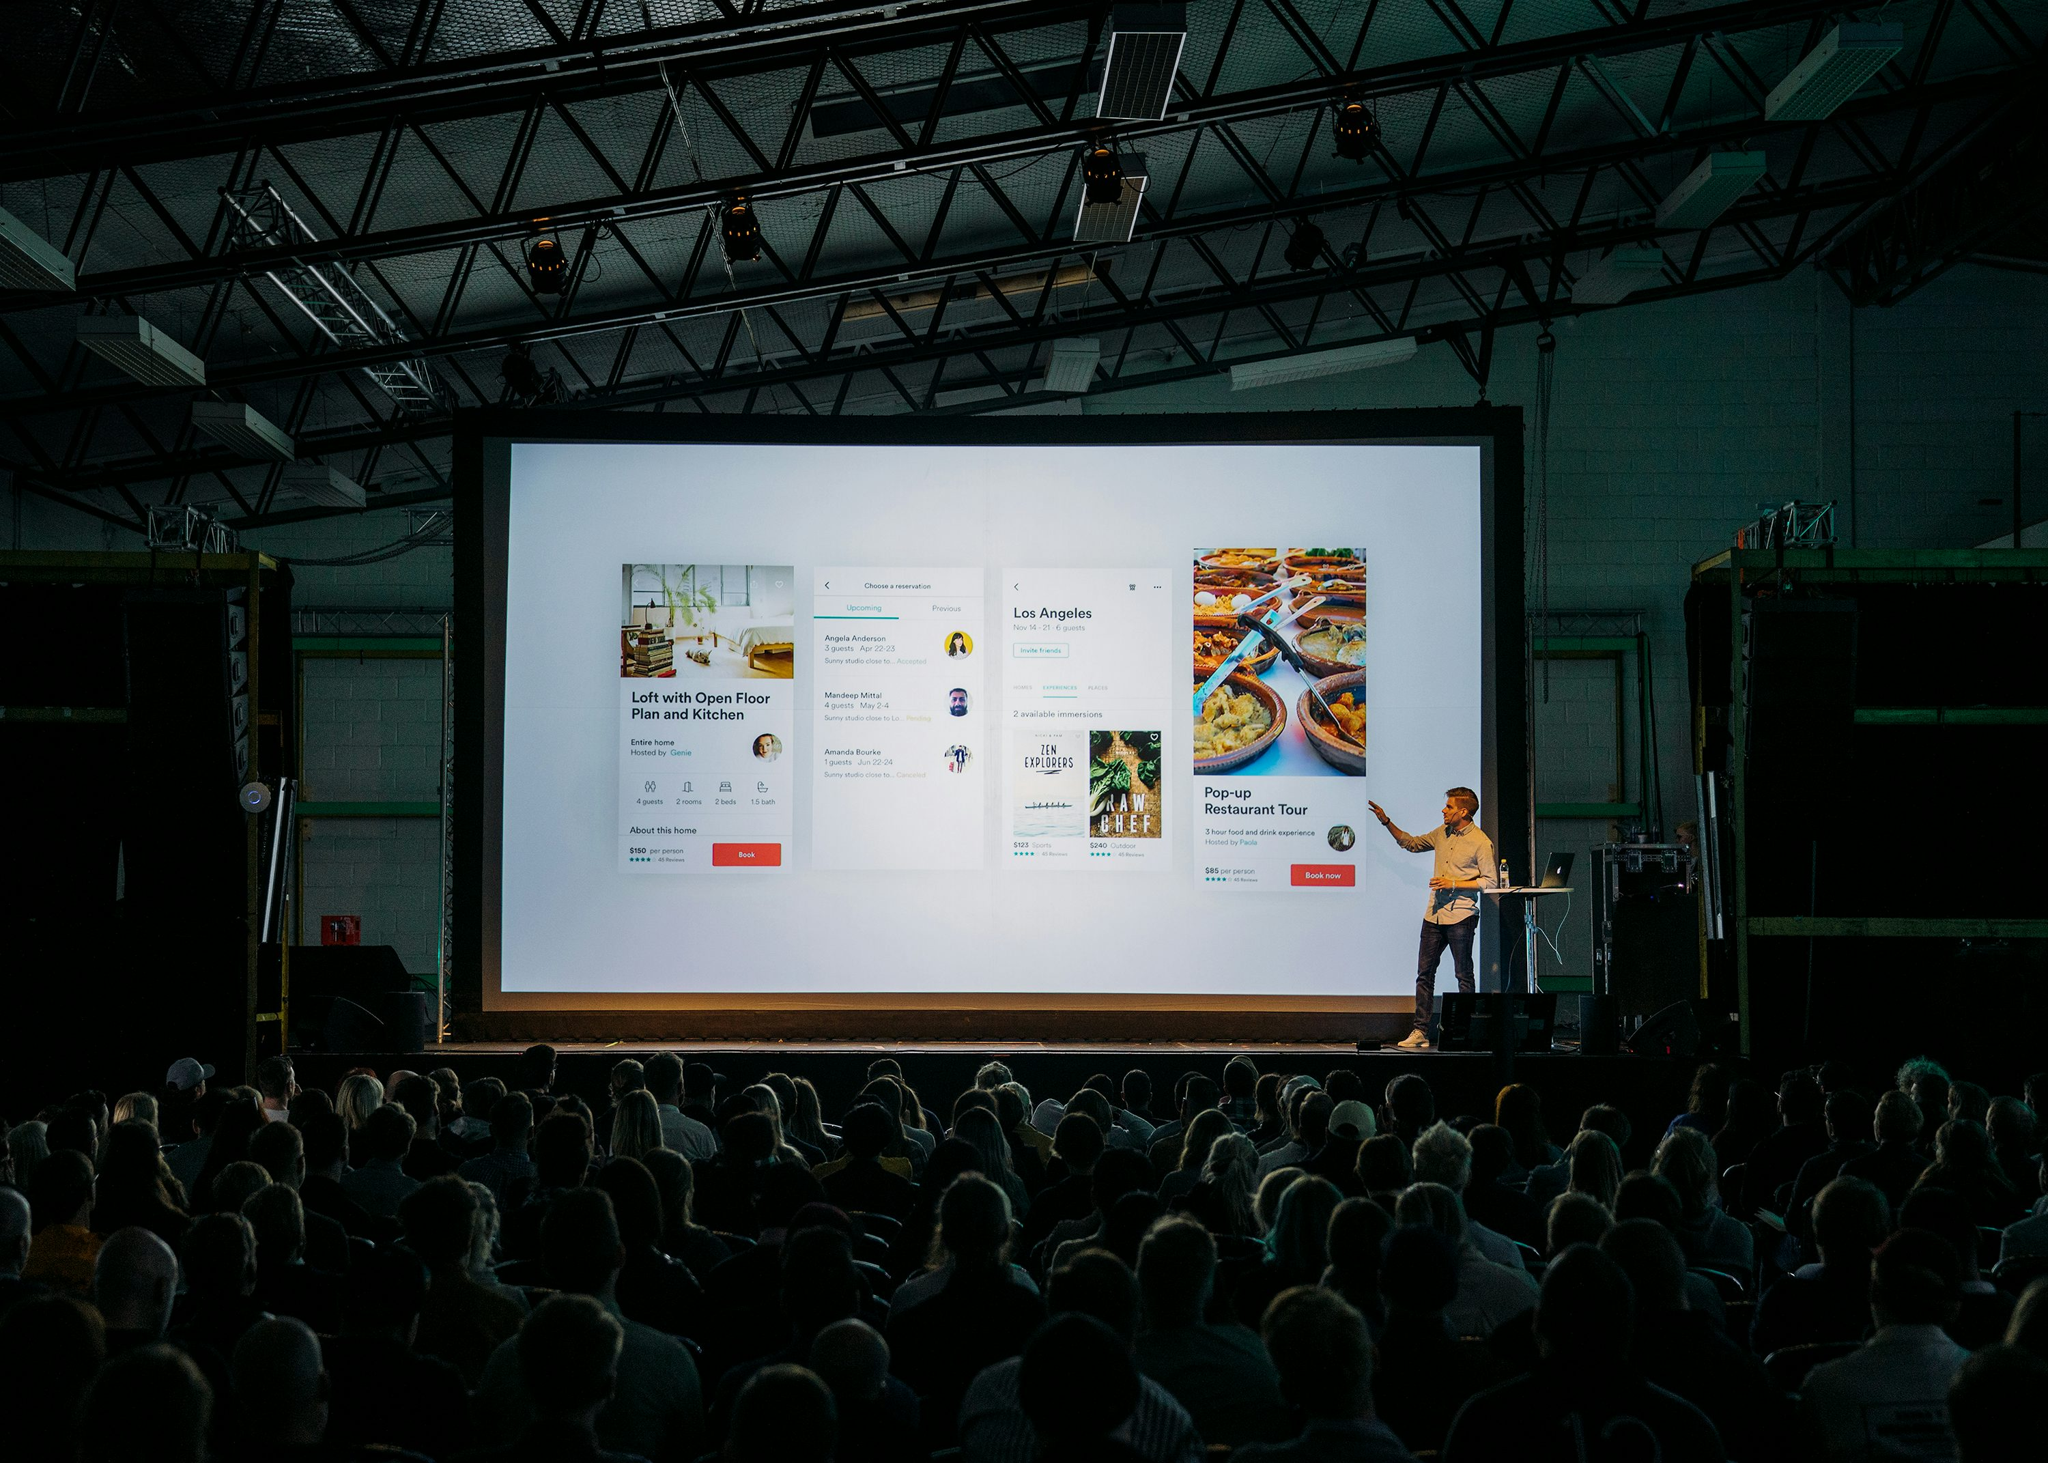
Please, I had a family…
Jeff won’t let me stop singing karaoke
I’m so tired
Please
help me
10 years ago…
I miss my wife

Slide 14
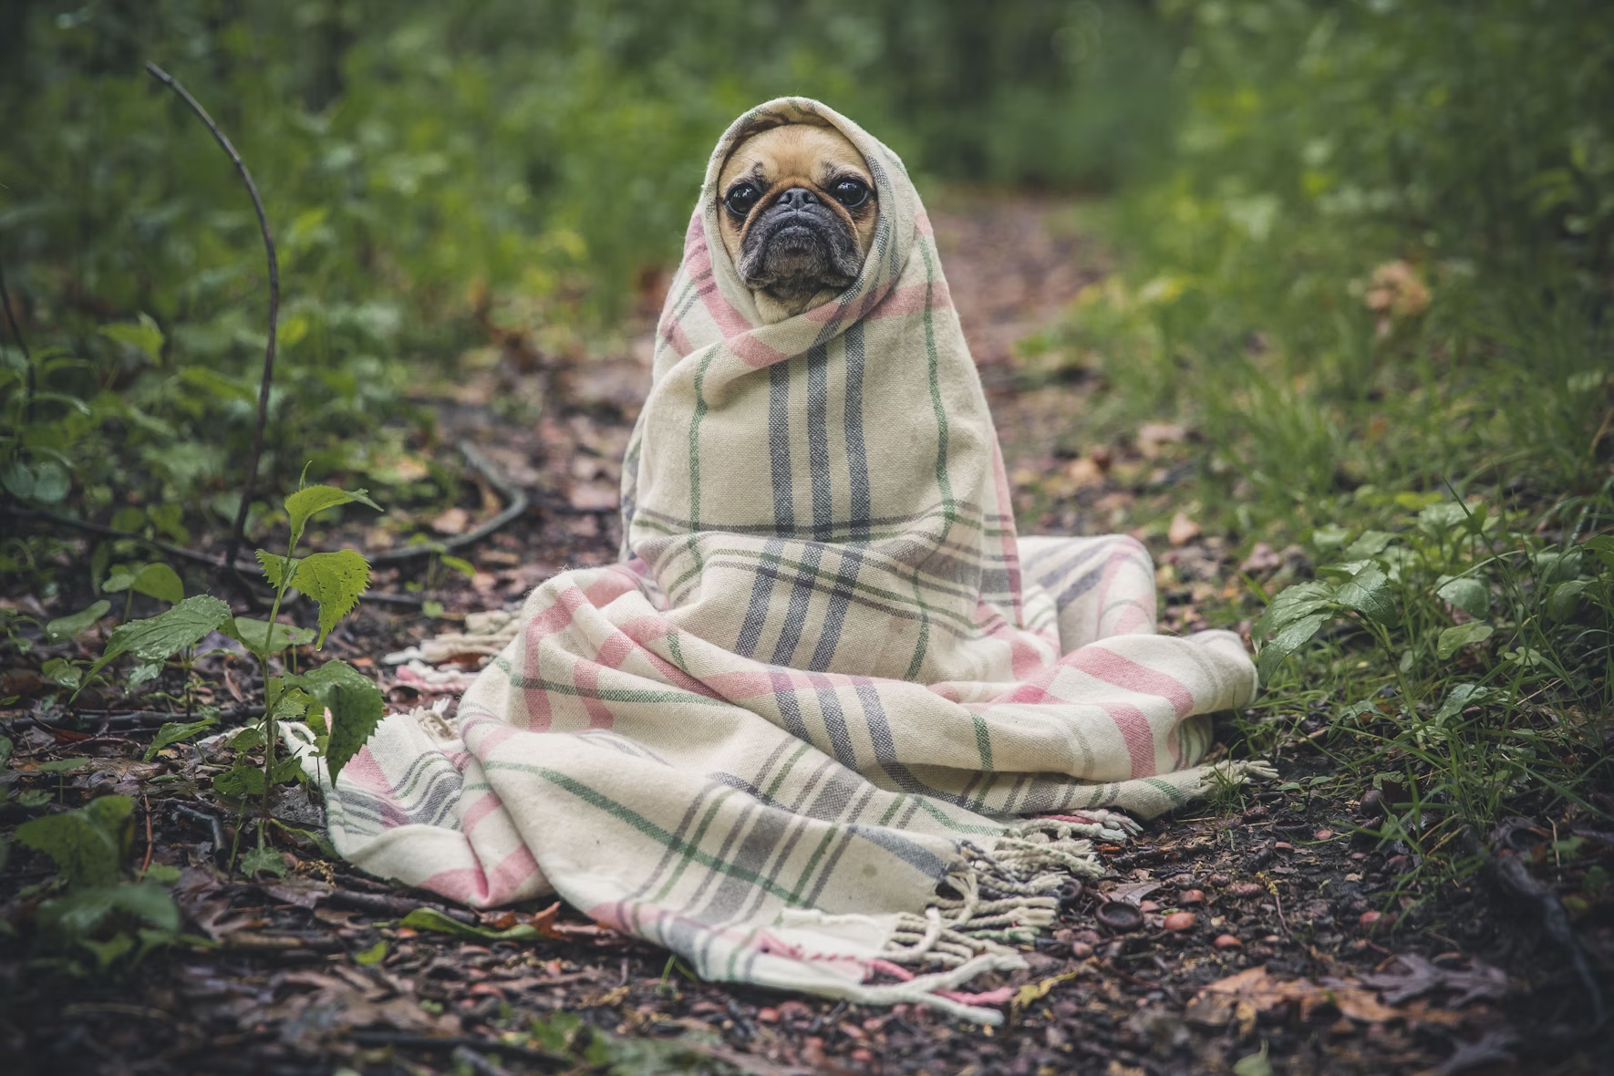
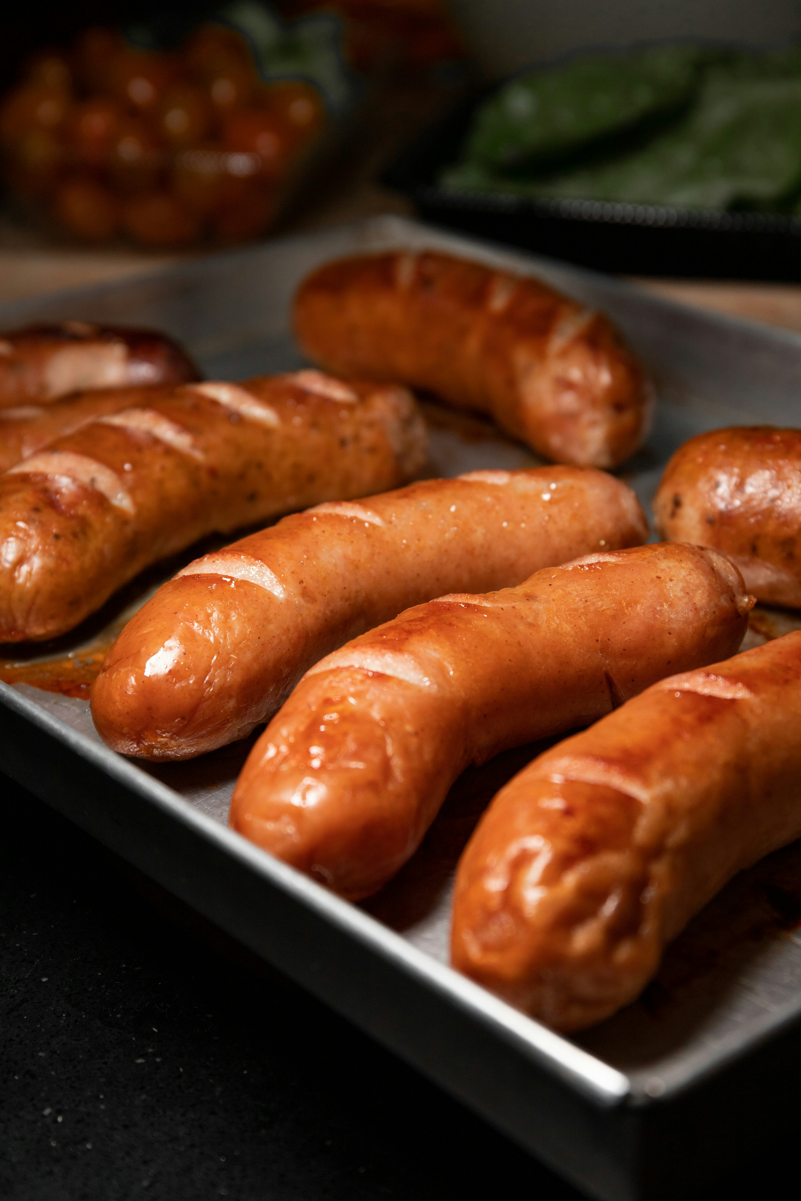
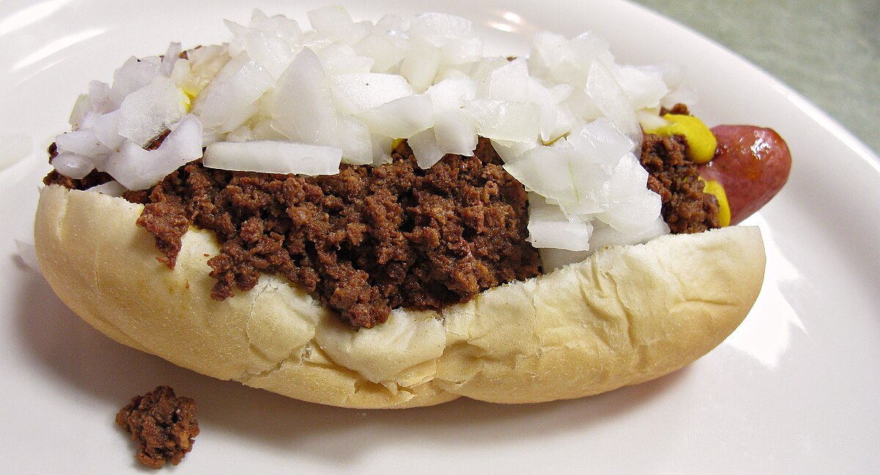

Slide 15
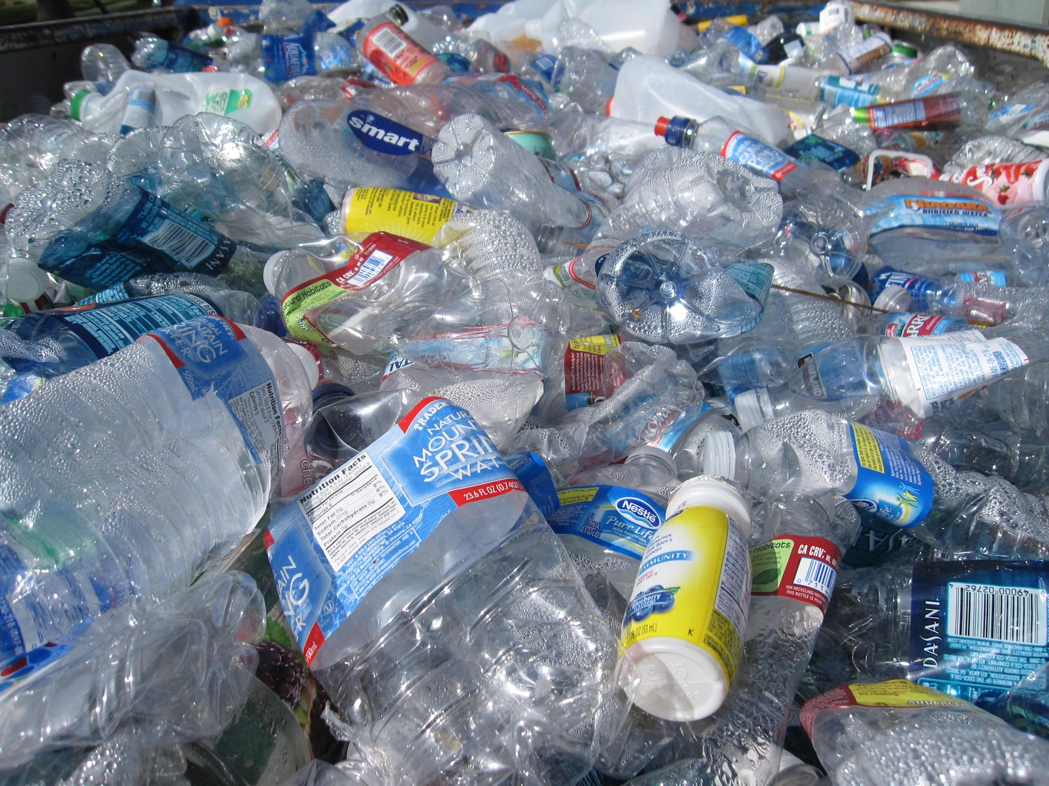


Slide 16




Slide 17
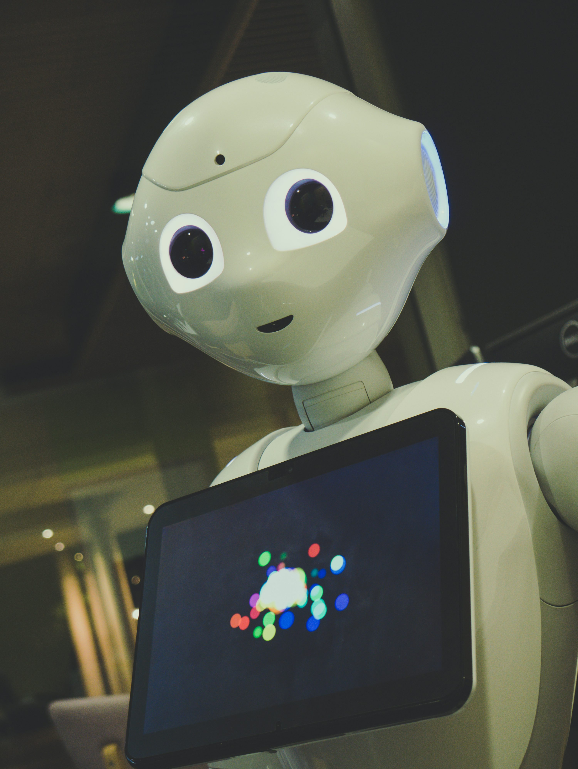
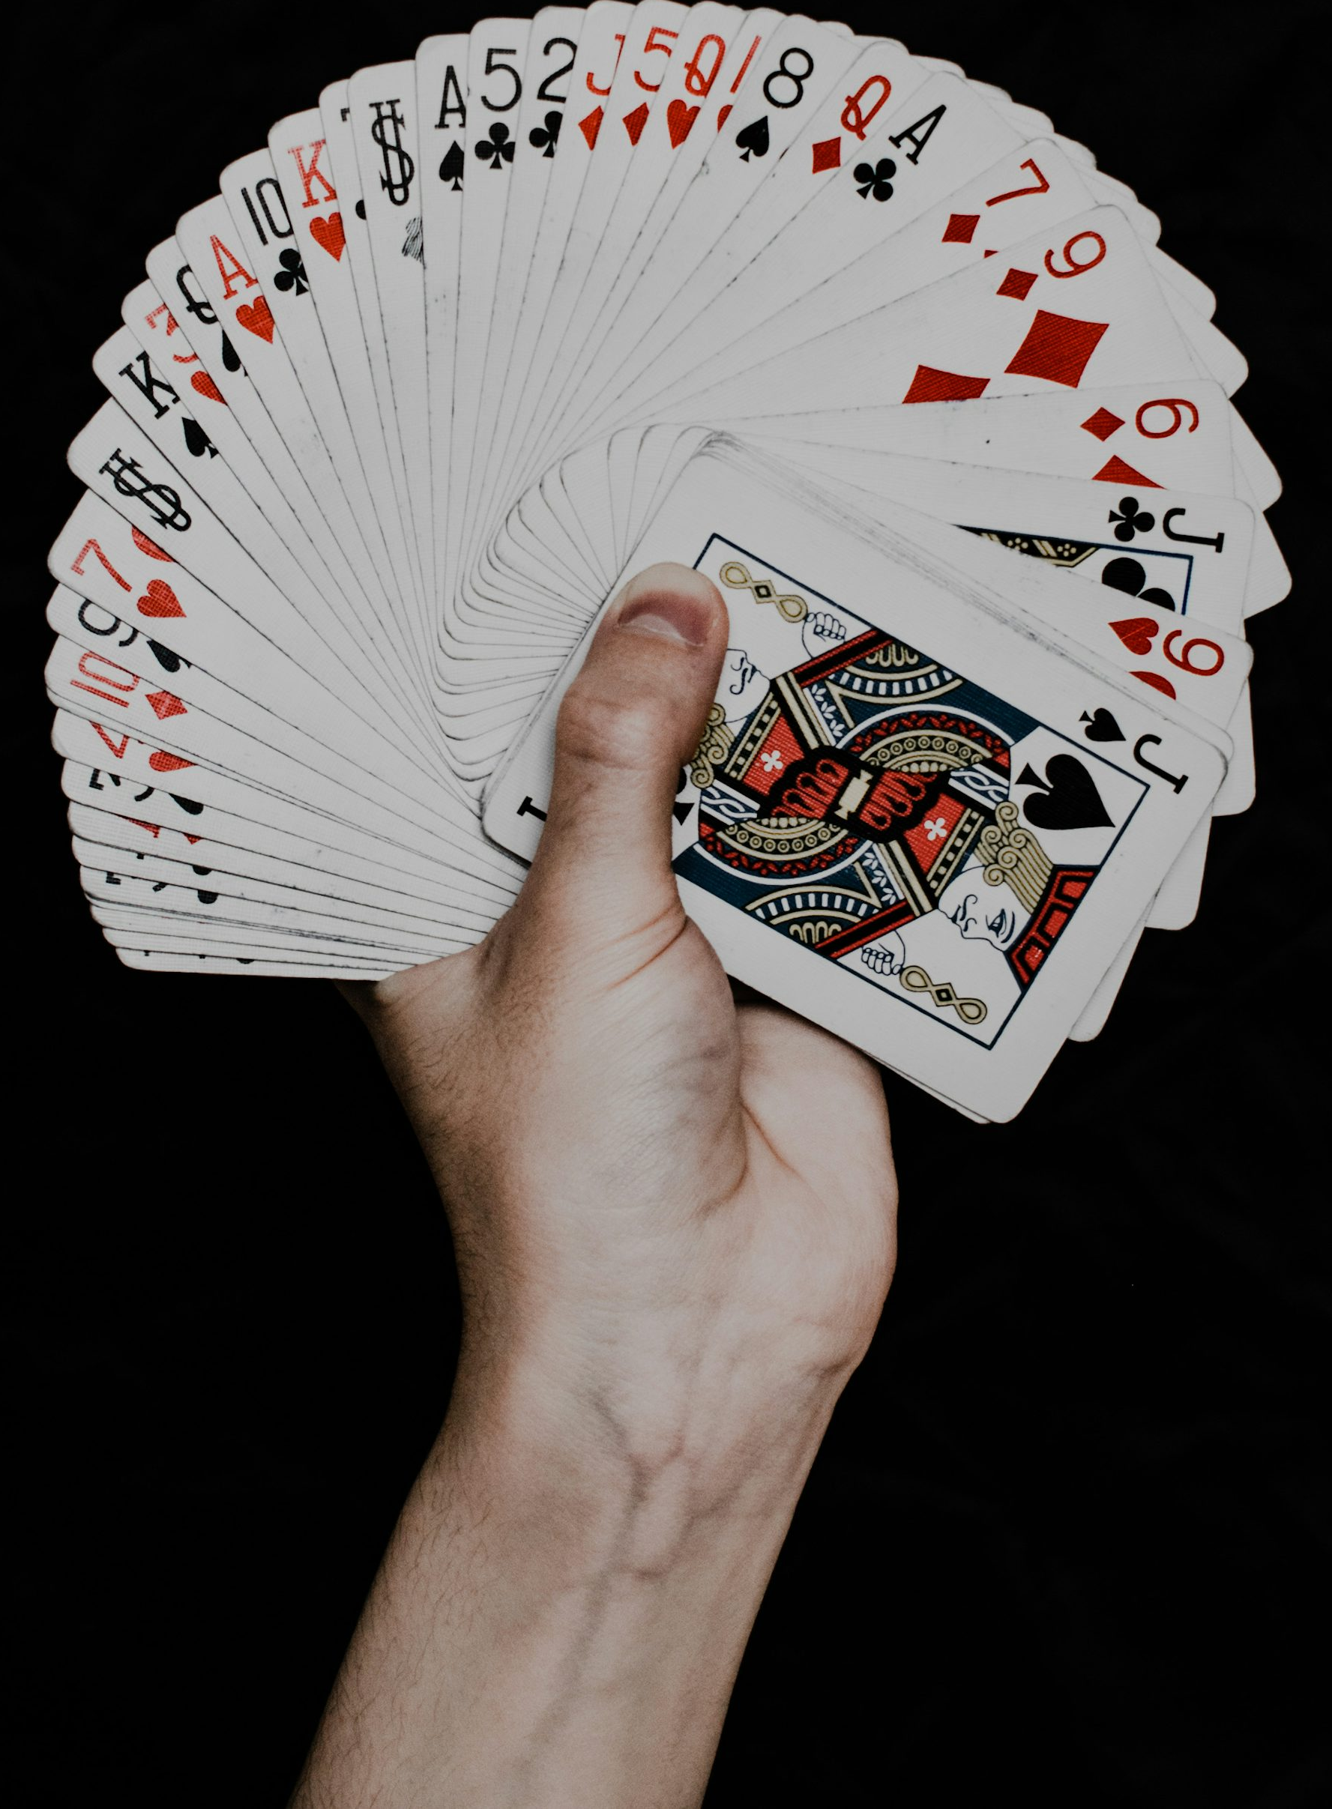

Slide 18
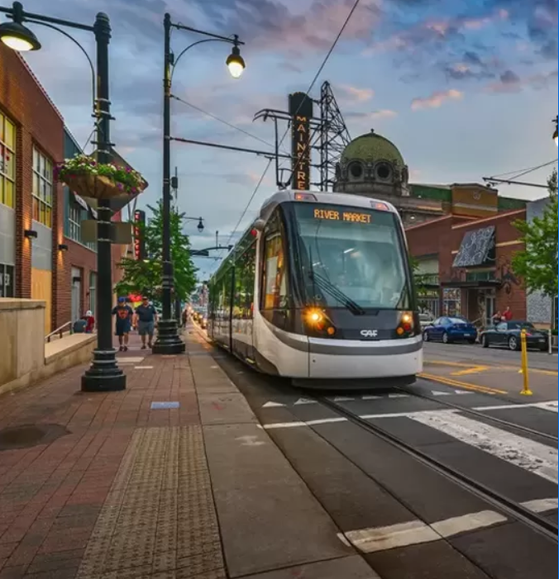



Slide 19


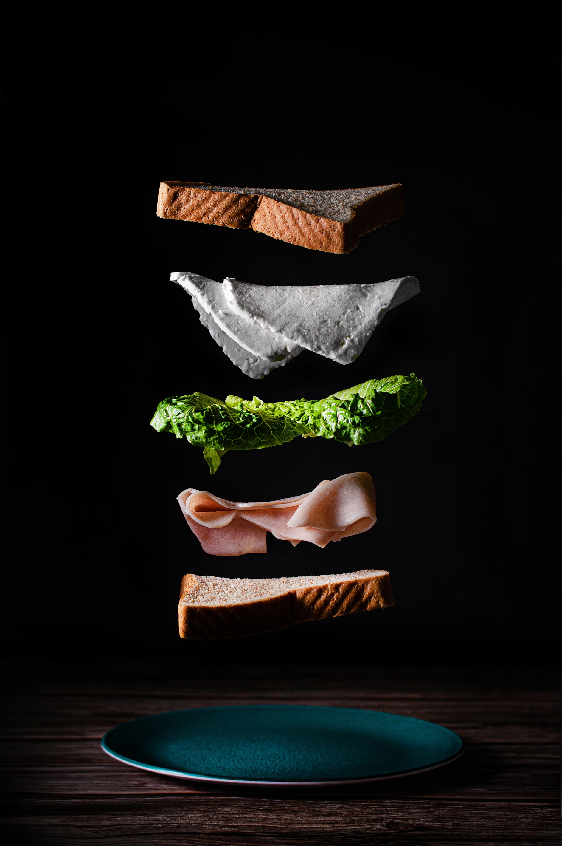

Slide 20
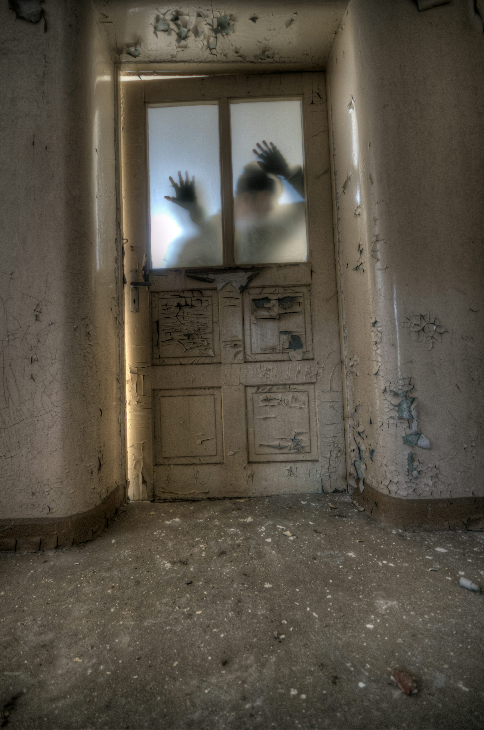
Notes:
Jeff drank so much he couldn’t figure out how to use a door.

Slide 21
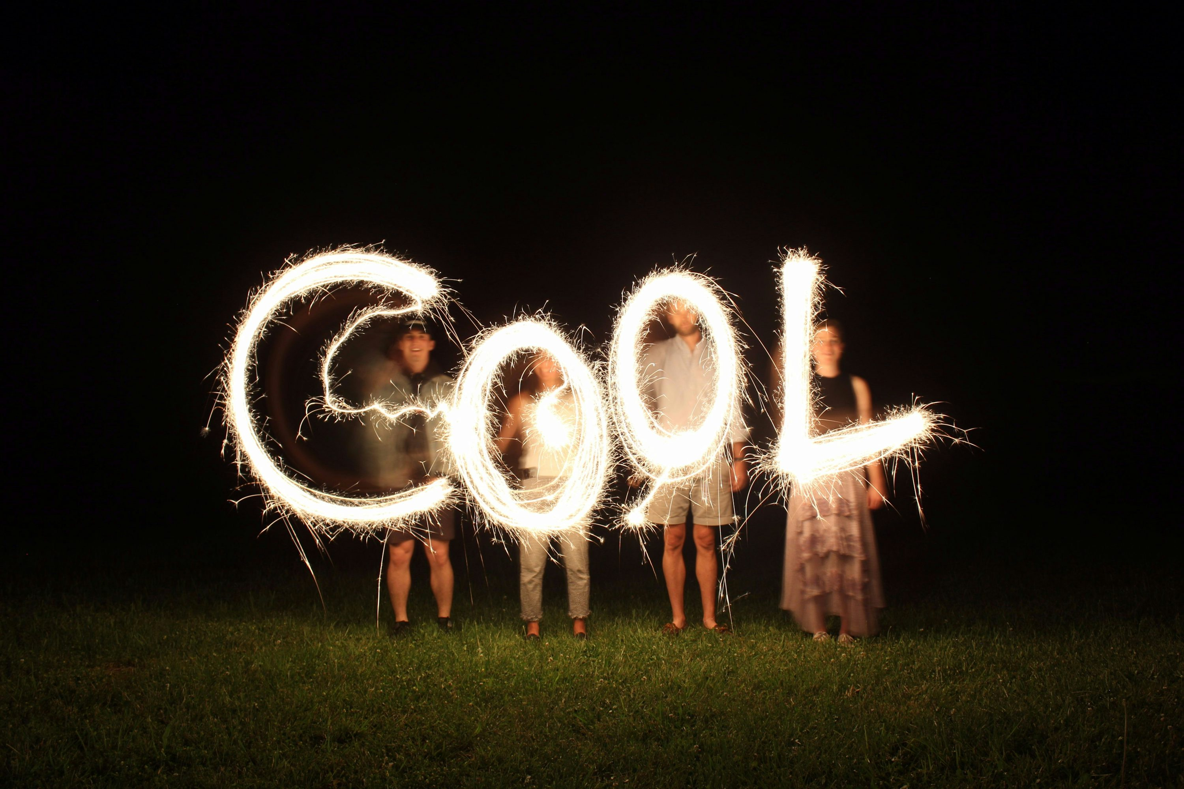
is
And we sponsored Pubconf

Slide 22
